Slide 1
Prepare the environment for a Microsoft Teams deployment

Slide 2
Module agenda
Upgrade from Skype for Business to Microsoft Teams
Plan and configure network settings for Microsoft Teams
Deploy and Manage Microsoft Teams endpoints

Slide 3
Upgrade from Skype for Business to Microsoft Teams

Slide 4
Lesson introduction
After this lesson, you will be able to:
Explain different upgrade paths for coexistence and upgrade modes
Manage the migration for meetings
Configure coexistence and upgrade settings

Slide 5
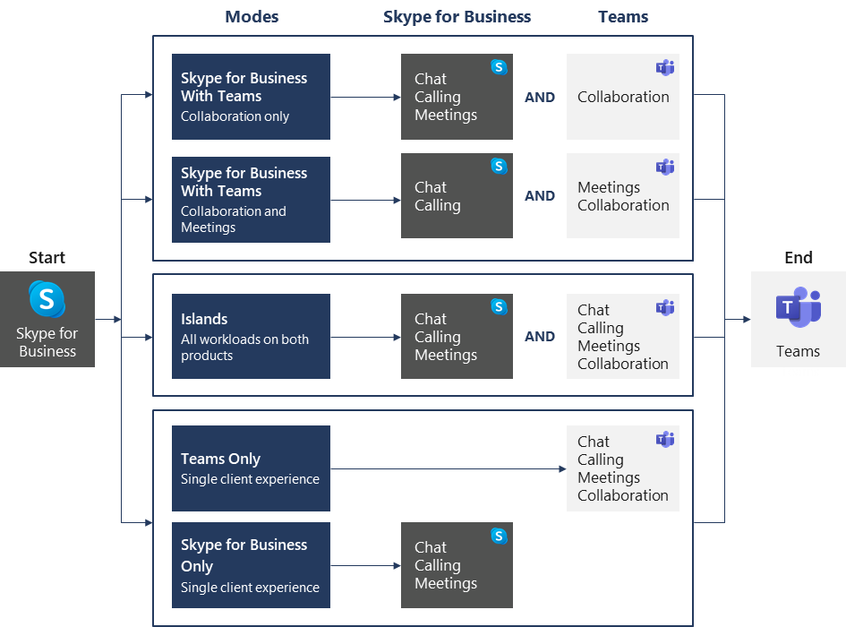
Evaluate upgrade paths with coexistence and upgrade modes
Two upgrade journeys:
Direct upgrade journey
Gradual upgrade journey
Notes:
Supporting videos for instructor or student use:
Introduction to Upgrade from Skype for Business to Microsoft Teams
https://www.youtube.com/watch?v=0COYetLjWmE

Slide 6
Manage meeting migration
Meeting Migration Service (MMS) provides updates for existing meetings:
When a user is migrated from on-premises to the cloud (SfB Online or to TeamsOnly)
When an admin makes a change to the user’s audio-conferencing settings
When an online user is upgraded to Teams only
When you use PowerShell to trigger MMS
Admins use Skype for Business Online PowerShell module to check the status of running migrations, manually trigger meeting migrations, and disable migrations
MMS is enabled by default for all organizations, but it can also be disabled on different levels:
Disable entirely for the tenant
Disable only for changes related to audio conferencing

Slide 7
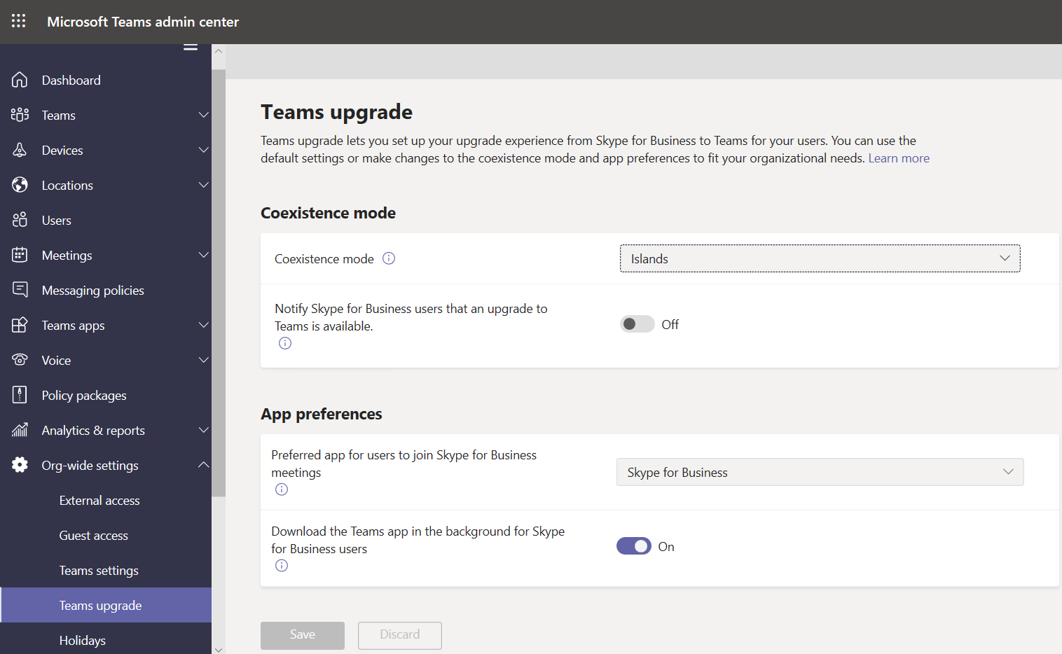
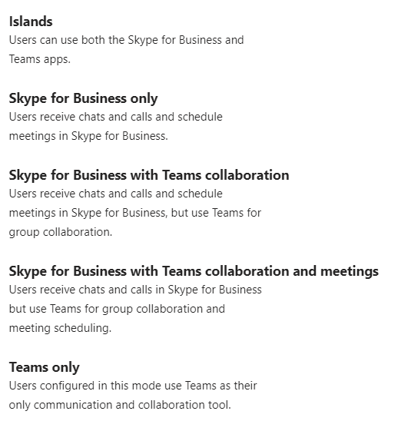
Configure coexistence and upgrade settings

Slide 8
Plan and configure network settings for Microsoft Teams

Slide 9
Lesson introduction
After this lesson, you will be able to:
Explain the network requirements of Microsoft Teams
Work with the Network Planner tool
Utilize the Network Test Companion
Describe the required network ports and protocols
Configure reporting labels for Microsoft Teams
Implement Quality of Service in your environment

Slide 10
Overview of Teams networking requirements
Three types of network traffic directions:
Data traffic between the Office 365 Online environment and the Teams client
Peer-to-peer real-time communications traffic
Conferencing real-time communications traffic
Analyze network capabilities (connectivity to Office 365, network quality, network health, available bandwidth, VPN, Wi-Fi, proxy servers)
Plan your network requirements (example: max. concurrent users)
Notes:
Supporting videos for instructor or student use:
Network Planning for Microsoft Teams
https://www.youtube.com/watch?v=vi3M7ZzF2NU

Slide 11
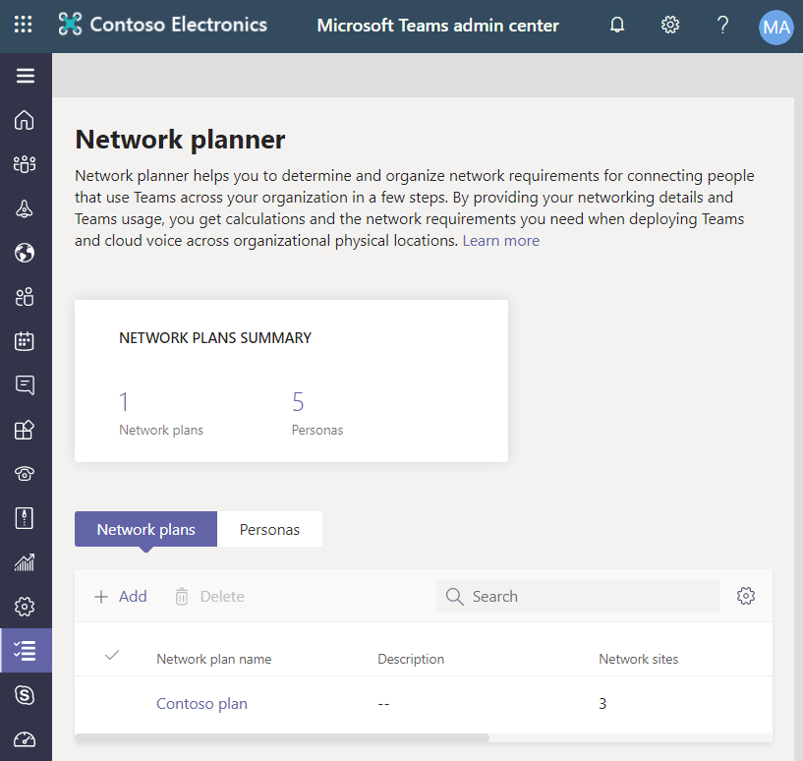
Use the Network planner
Network planner features:
Generate reports and calculate bandwidth requirements for Teams usage
Create representations of your organization using sites and Microsoft recommended personas
Required permission to access Network planner:
Global Administrator,
Teams Service Administrator,
Teams Communications Administrator.
Create a custom persona
Build your plan
Create a report

Slide 12
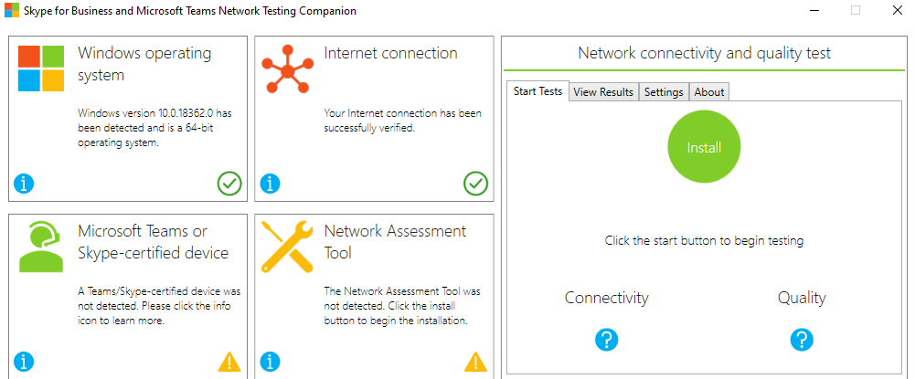
Use the Network Testing Companion
Network Testing Companion is used to test the network quality and connection to Skype for Business Online or Microsoft Teams
Notes:
Recommend to demo the tool.

Slide 13
Configure network ports and protocols
All clients that use Office 365 cloud-based services, including Microsoft Teams, need to connect to the Office 365 endpoints, which represent set of destination IP addresses, DNS domain names, and URLs for Office 365 traffic on the Internet
These endpoints change regularly. It is critical that you adopt a change management process for Office 365 endpoints
Scenario | Source IP/Port | Destination IP/Port
Non real-time traffic | Client IP High ports | Office 365 80, 443 TCP
Real-time media traffic | Client IP 50,000-50,059 UDP | Transport Relays 3478-3481 UDP

Slide 14
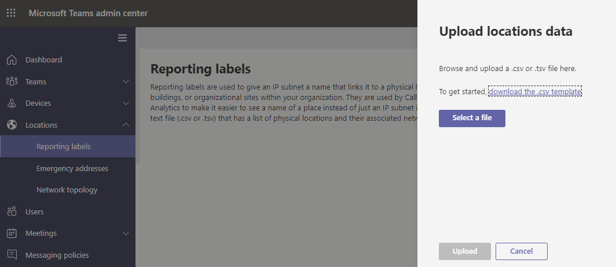
Configure reporting labels for Microsoft Teams
Use reporting labels to organize the physical locations of offices, buildings and organizational sites. The report labels and locations data are used for generating reports for Call Analytics and the Call Quality Dashboard

Slide 15
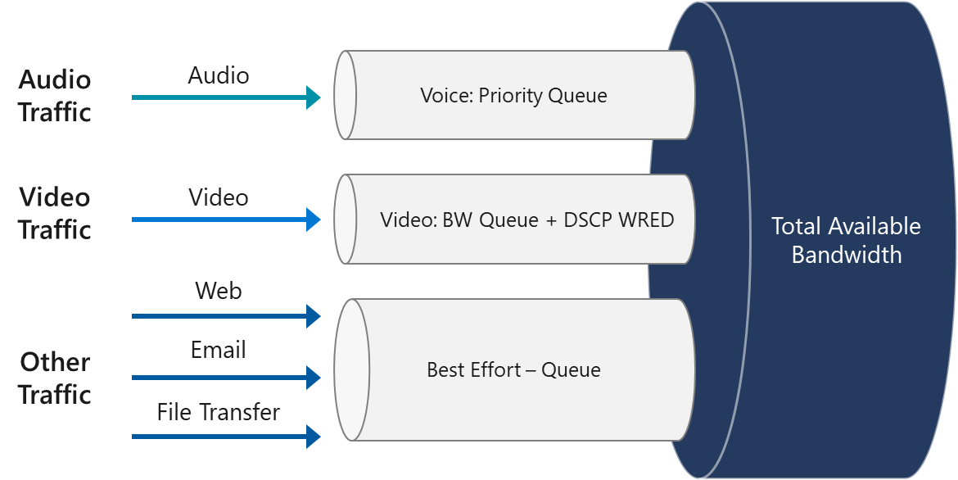
Implement Quality of Service (QoS)
Quality of Service (QoS) is a mechanism you use to prioritize certain types of network traffic
Implement QoS:
Verify if a network is ready for QoS
Select a QoS implementation method
Choose initial port ranges for each media type
Implement QoS in the Teams admin center
Validate the QoS implementation
Migrate a QoS solution to Teams

Slide 16
Deploy and manage Microsoft Teams endpoints

Slide 17
Lesson introduction
After this lesson, you will be able to:
Deploy Microsoft Teams to devices
Manage device settings and firmware
Manage configuration profiles
Configure Microsoft Teams Rooms

Slide 18
Deploy Microsoft Teams clients to devices
Operating systems for Teams desktop clients:
Windows (8.1 or later) and Windows Server (2012 R2 or later), 32-bit and 64-bit versions
MacOS 10.10 and later
Linux .deb and .rpm formats
Operating system for VDI
Teams mobile clients:
Android
iOS
Web client
Client update management

Slide 19
Manage device settings and firmware
For a device to be managed in Teams Admin Center, it must be certified for Teams and enrolled in Teams
Management tasks:
Change device information
Manage software updates
Restart a device
View device history
View diagnostics
Notes:
https://products.office.com/en-us/microsoft-teams/across-devices

Slide 20
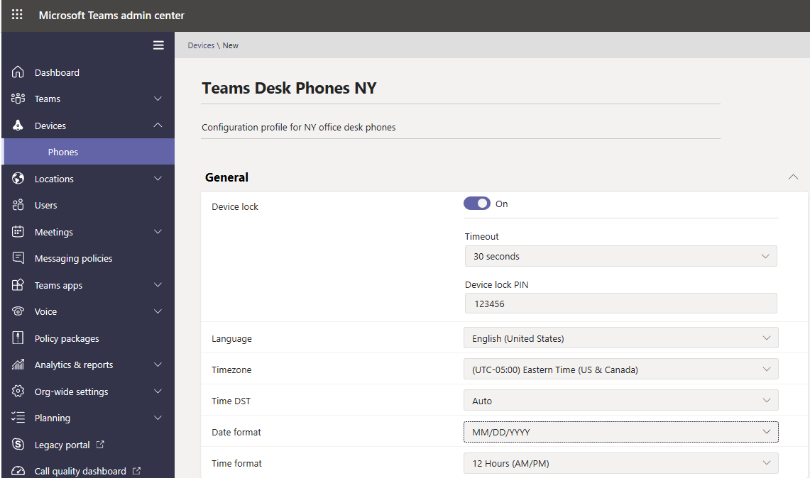
Manage configuration profiles
Manage settings and features for Teams devices in your organization
Create a configuration profile
Assign a configuration profile
Notes:
Supporting videos for instructor or student use:
Microsoft Teams Phones and Peripherals for enhanced meeting and calling experiences
https://myignite.techcommunity.microsoft.com/sessions/83485?source=sessions

Slide 21
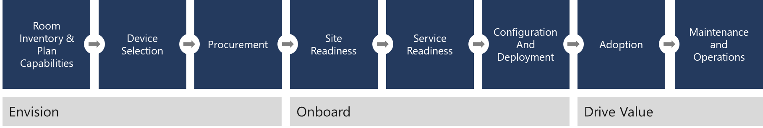
Configure Microsoft Teams rooms
Account provisioning
Microsoft Teams Rooms application and peripheral device configuration
Device software installation
Testing
Device deployment
Asset management
Microsoft Teams rooms deployment
Notes:
Supporting videos for instructor or student use:
Transform every meeting with Microsoft Teams Rooms:
https://www.youtube.com/watch?v=5VBRa4s1hVM

Slide 22
Lab: Plan and configure network settings for Microsoft Teams

Slide 23
Lab exercises
Exercise 1: Calculate Network capabilities
Exercise 2: Evaluate configuration profiles
Exercise 3: Provide Teams resources

Slide 24
Closing slide

